Slide 1
Credit EDA Analysis
Anashwara AV

Slide 2
Problem Statement
We are provided with a credit provider details of their loan applications and their outcome i.e. if he loan has been defaulted or not.
We have around 122 parameters in application.csv and around 22 in previous_application.csv.
We need to analyze the data and find out the parameters which seems to have high affect in defaulting of a loan
In further slides, target 0 indicates that the customer is not defaulter, target 1 means customer is a defaulter

Slide 3
Data Metrics and Roadmap
Records in application.csv: 307511
Records in previous_application.csv: 1670214
The brief steps that we take for the analysis are:
Missing values analysis and imputation
Outlier analysis
Binning and imbalance
Unvariate analysis
Bivariate analysis
Segmented univariate analysis
Ratio analysis
Correlation
Conclusions

Slide 4
Missing values analysis and imputation
We got around 17 rows for which more than 60% data was missing
After observing these columns we found out that CAR_AGE column with 65% missing value was closely related with OWNS_CAR
It was observed that for a large number of records where car age is missing, the OWNS_CAR column was N which means they did not own a car. Thus car age was safely imputed to zero for such cases.
Similarly for other columns with less than 50% missing values a method called hot deck imputation can be used.
Hot deck imputation is a method for handling missing data in which each missing value is replaced with an observed response from a “similar” unit. i.e eg. If ‘occupation type is missing, we will take other parameters in row like amt_credit, income etc and check which rows have similar income or amount credit and then substitute that occupation in the missing value.
This ensures that a more accurate imputation is happening instead of straight imputation with median/mode

Slide 5
Outlier detection
Steps used:
Calculate first quartile Q1
Calculated third quartile Q3
Inter quartile range = Q3-Q1
All outliers lie above Q3+1.5IQR and below Q1-1.5IQR

Slide 6
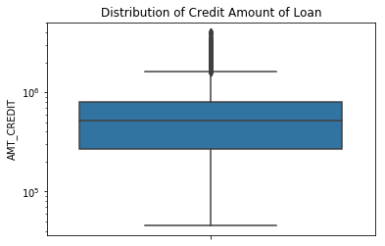
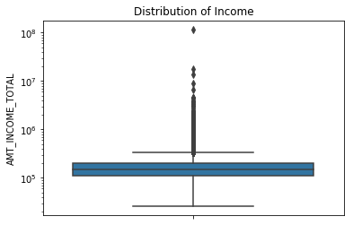
Outlier detection
Amount Credit Total Income
Outliers : 43 Outliers:1441

Slide 7
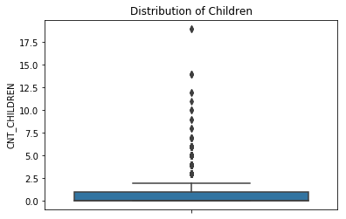
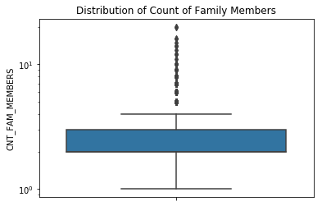
Outlier Detection
Count of Children Count of Family members
Outliers: 42 Outliers: 121

Slide 8
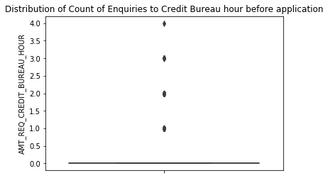
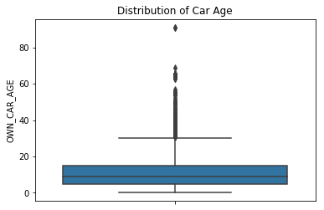
Outliers
Enquiries to Credit Bureau Car Age
hour before application
Outliers: 1626 Outliers: 3341

Slide 9
Correction and imputation
Days Employed:
For the column days employed, we observed that, mostly the days employed were negative values, but there were around1/6th of the values positive and majority of them has the value 365243 i.e around 1000 years.
Then we checked it with the income type and found out that for most pensioners and unemployed people, the value was positive.
The values for unemployed seemed to be correct, but for pensioners the value came out to be 365243 which may be a default value put while accepting the application.
So we need to change this value to some other value or in general can be substituted by 60 -20 = 40 years which is a normal year span for employment.

Slide 10
Binning
Binning is used to categorize the continuous variables to discrete categories so that we can have a better visualization of the trend.
As we know that generally, the income is related to the age group of the person and hence, we categorized ages into different age groups.
20-30(newly employed having good future in payment of loans),
30-40( usually higher earning section),
40-50( higher earning and near to pension/ leaving the job),
50-60( some already retired and some on verge of retirement),
60-70( mostly retired individuals who usually live on pensions)
These bins are helpful in classification of data into different groups
Similar binning can be done for number of members in the family to indicate if it is a joint family or a nuclear family

Slide 11
Imbalance
Ideally it is expected that there are equal instances for all the values in the target output variable.
But most of the times this does not hold true. This leads to imbalance in the data that we have for analysis
Imbalance for our target variable can be given as
Imbalance for 1 = (number of records with target 1)/ (number of records with target 0)*100
Imbalance for 1: 8.781828601345662 %

Slide 12
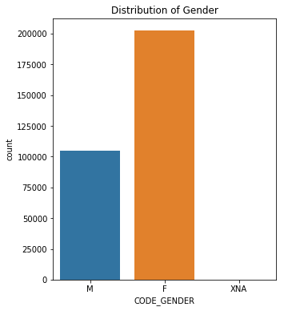
Univariate analysis – Application.csv
Number of applications gender wise
So , maximum number of loan applicants are female

Slide 13
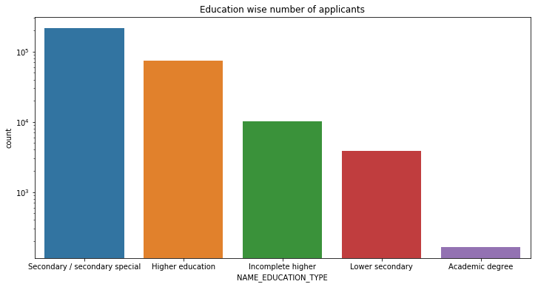
Univariate analysis – Application.csv
Number of applicants per education type
So maximum number of applications come from people who have secondary/ secondary special as the education type

Slide 14
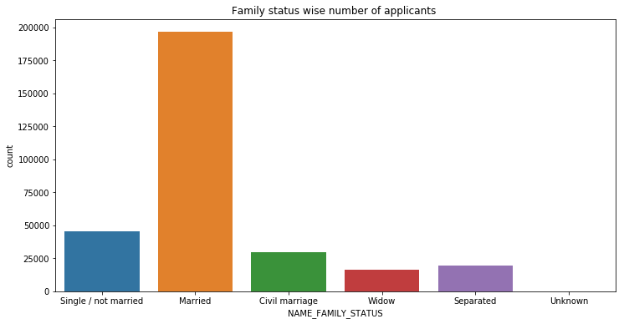
Univariate analysis – Application.csv
Number of applicants family status wise
So married people are highest in the number of applicants

Slide 15
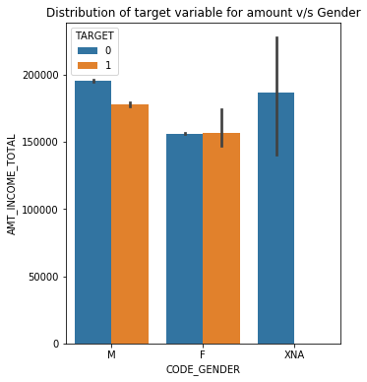
Bivariate Analysis- Application.csv
Effect of gender and mean income on Target variable
This shows that, in case of male customers, the defaulters had less mean income that non- defaulters, whereas in case of female customers, the income almost remained similar for defaulters and non defaulters. We can ignore XNA as it has only 4 records but just kept it for overview

Slide 16
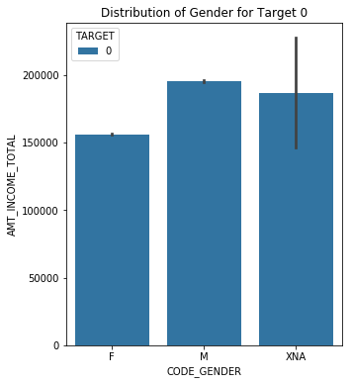
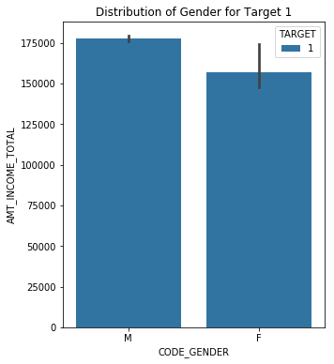
Bivariate Analysis- Application.csv
Effect of gender and mean income on target 0 and 1 separately
This shows that, women who are defaulters have a whole range of income although the mean is lower than men. Thus there is a lot of variation in the income of defaulters women.
Note: The black line indicated the spread of values for the mean income.

Slide 17
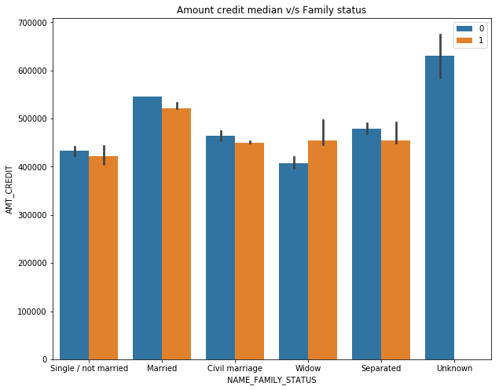
Bivariate Analysis- Application.csv
Amount credit v/s Family status
The above graph indicates that in most cases, the amount credited y defaulters is less than the amount credited by non defaulters. But, in case of widows, the amount credited for defaulters is more than non defaulters

Slide 18
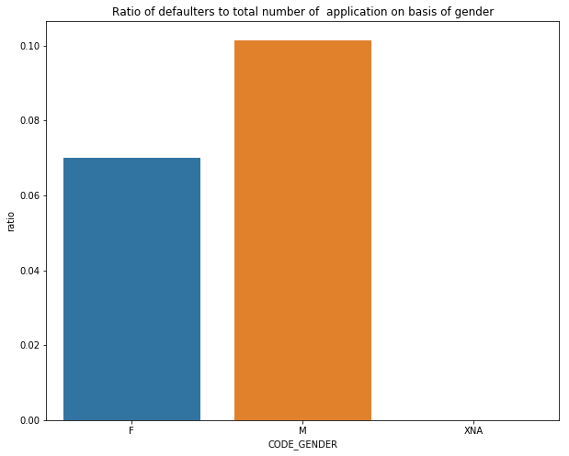
Ratio analysis
So we analyzed the ration of people getting defaulted to total applications to find some interesting conclusions
Gender ratio
Thus, chances of men defaulting are higher than women defaulting

Slide 19
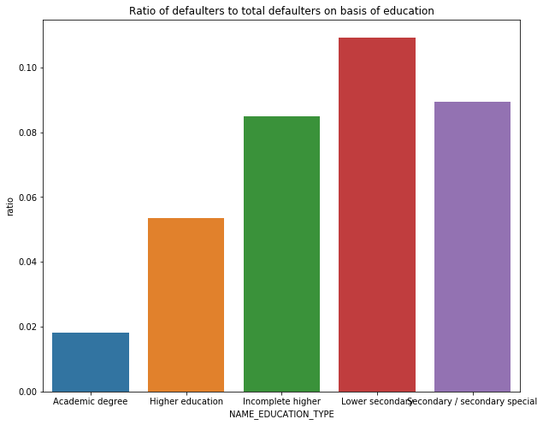
Ratio analysis
Education type
Chances of person with lower secondary education defaulting is higher

Slide 20
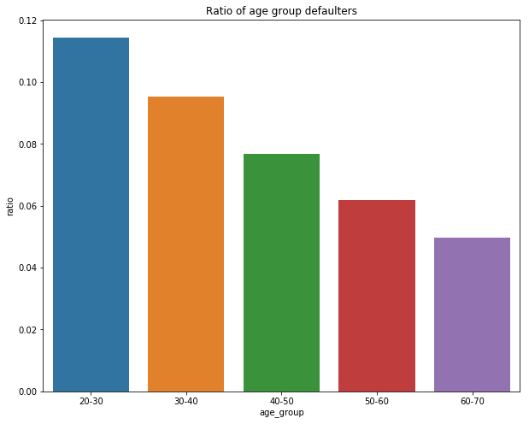
Ratio analysis
Age group
Chances of 20-30 age group people being defaulters are higher

Slide 21
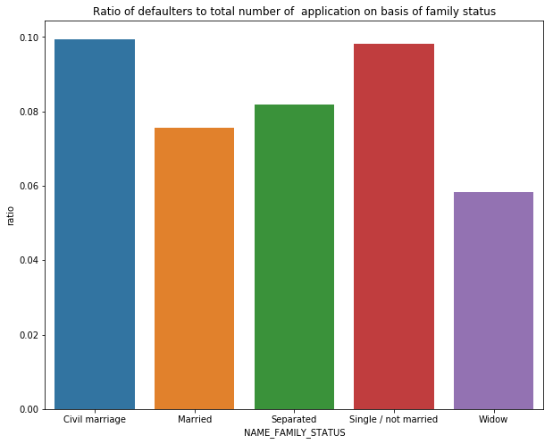
Ratio analysis
Family status
Chances of people with civil marriage and single /unmarried people being defaulters are greater

Slide 22
Correlation
We found the top correlated variables to the target variable and found out that
Top positively correlated are
DAYS_BIRTH 0.078
REGION_RATING_CLIENT_W_CITY 0.061
REGION_RATING_CLIENT 0.059
DAYS_LAST_PHONE_CHANGE 0.055
Top negatively correlated are
EXT_SOURCE_3 -0.179
EXT_SOURCE_2 -0.160
EXT_SOURCE_1 -0.155

Slide 23
Conclusion
Thus from correlation and ratio analysis we came to the conclusions that:
Age group of 20-30 are mostly at a risk of becoming defaulters.
Single / unmarried people are at a risk of becoming defaulters than others
Male are more prone to be defaulters
People with secondary education are prone to be defaulters.

